Slide 1
SENIOR LIVING
Group Volunteer Recruitment
Kathleen Pursell
Arkansas SMP
Program Director
Notes:
It has always been a challenge for the AR SMP to recruit volunteers, so we have been working on a new way of recruiting volunteers.

Slide 2
VOLUNTEERS
MISSION:
RECRUIT VOLUNTEERS
Peer – to – Peer
Protect, Detect & Report
Notes:
The SMP programs rely heavily on volunteers to help carry out its mission to educate seniors, their caregivers and family members to be more responsible healthcare consumers. And the thought is that it works better through Peer-to-Peer Interaction because they
Trust each other
All on Medicare
All being affected
All going through the same thing together

Slide 3
GROUP VOLUNTEER RECRUITMENT
Target:
Senior Housing Facilities
Protect, Detect & Report
Notes:
In a new endeavor to step up our efforts to recruit volunteers in AR, this past year we started an initiative to focus on group volunteer recruitment particularly in senior housing settings.
Why Housing Facilities?
It all started after a presentation in a retirement village a couple of years ago. After the presentation I was contacted by one of the members of an already established “retired nurses’ group’ within the community. They said they chose SMP to be their project for the coming year. We met and I gave them samples of the materials I wanted them to distribute to the residents and discussed our partnership. Because of the wonderful success we have had with this group, we decided to use it as a ‘pilot’ or model and try to duplicate it in other housing facilities statewide.

Slide 4
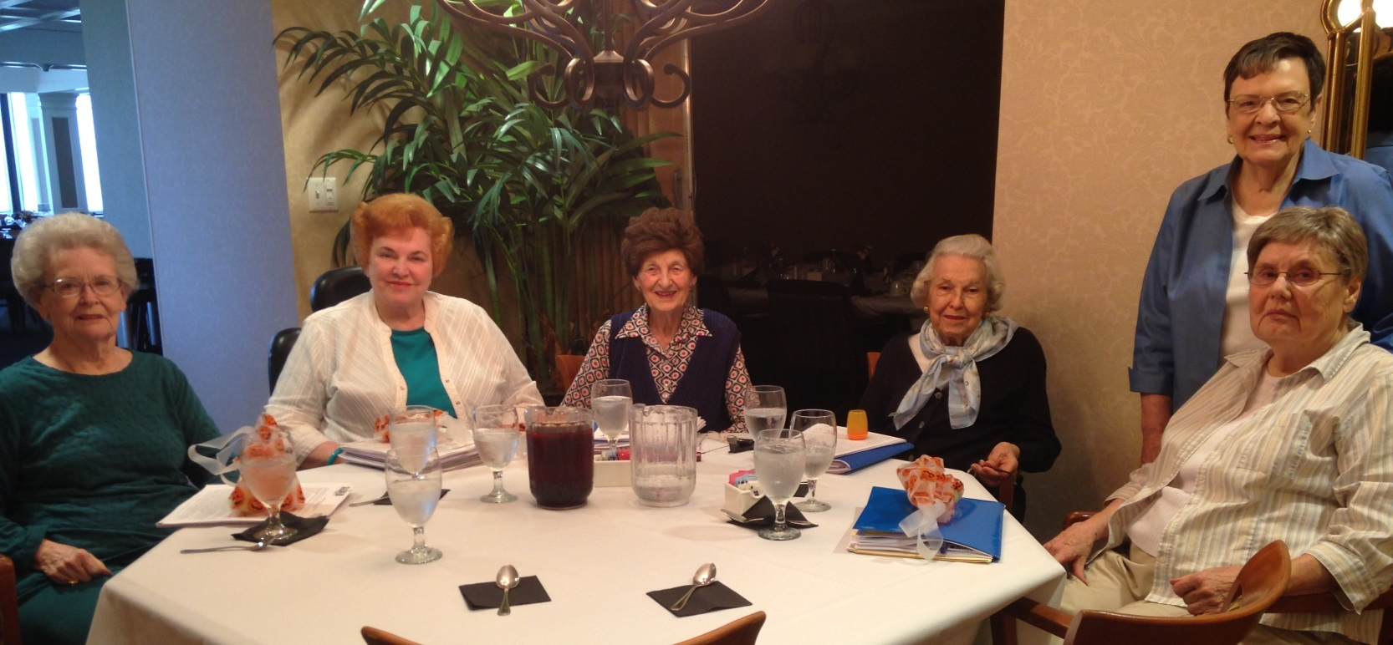
GROUP VOLUNTEER RECRUITMENT
RETIRED NURSES’ GROUP
Woodland Heights Retirement Village
Notes:
This is that group

Slide 5
GROUP VOLUNTEER RECRUITMENT
Progress Made
VIDEO - Group Volunteer Recruitment
Notes:
The model has worked so well, we developed this video strategically to show to Administrators and Event Coordinators (or activity directors)
Which helps to give them an idea of how the volunteer program would work in their community setting.
SHOW VIDEO

Slide 6
BENEFITS:
THIS HAS PROVEN TO BE A WIN-WIN FOR ALL INVOLVED:
Notes:
This approach is a WIN-WIN for all involved – the SMP, the administration AND its residents

Slide 7
BENEFITS to the
Administration:
Keeps their residents-
Informed;
Educated; and
Protected
Notes:
It is beneficial to the Administration because it keeps its residents informed, educated and protected!

Slide 8
BENEFITS to the:
Volunteers - (most rewarded):
Sense of Purpose
Community involvement
Not limited by handicap(s)
Weather is not an issue
Trust is not an issue
No need to drive!
Making a difference (residents’ lives!)
Forming peer-to-peer relationships
Meeting neighbors and making new friends!
Notes:
For some, this knock on the door may be the only visitor they get, which could make all the difference in the world to someone. Just a ‘hello’ and ‘hope you are doing ok’….’here are some important materials for you! Have a nice day!’
And a good thing to point out is that one is not limited by the weather or by a handicap!
Read slide…

Slide 9
BENEFITS
to the SMP:
Increase in measureable outcomes.
Reporting measures are increasing.
Notes:
Because this is a GRANT program, we know we are accountable for the number of volunteers we recruit and their volunteer hours, as well as the number of people we reach with our message.

Slide 10
GROUP VOLUNTEER RECRUITMENT
Volunteer Effort:
Distribution of Informational Materials:
Fraud / Scam Alerts
Medicare Minutes
SMP Qtrly Newsletter
Reporting volunteer time!
Notes:
This is helping to give the SMP program and materials visibility on a regular basis to those living in the community - Through dissemination of relevant Medicare updates through monthly Medicare Minutes (provided by the Medicare Rights Center); also the latest fraud and scam alerts; and our quarterly SMP newsletters..

Slide 11
MATERIALS-
Notes:
Here is a sample of what our Scam Alerts / Fraud Alerts look like
We distribute these as new scams arise.
It is the same format each time with
the name of the scam
How it works
Best Response

Slide 12
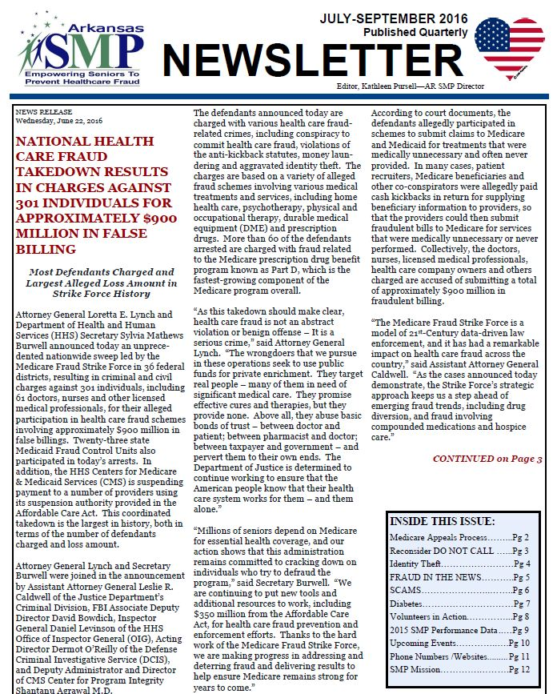
MATERIALS-
Notes:
This is our quarterly newsletter

Slide 13
MATERIALS-
Notes:
If any of you work with the Medicare Minutes, this is a sample of what it looks like.
So, we typically have at least one document to distribute monthly, but sometimes we have 3.
We may also give a promotional item every now and again to spice things up!

Slide 14
BENEFITS
to the SMP:
June 2015 – June 2016
7 HOUSING FACILITIES
VOLUNTEERS RECRUITED 41
HOURS REPORTED 350
PEOPLE REACHED 670
Notes:
So let’s look at the numbers for this past year:
To date, we now have 7 housing facilities
We have recruited 41 new volunteers (just in community settings)
Who have reported 350 hours!
And we reach almost 700 people on monthly basis.

Slide 15
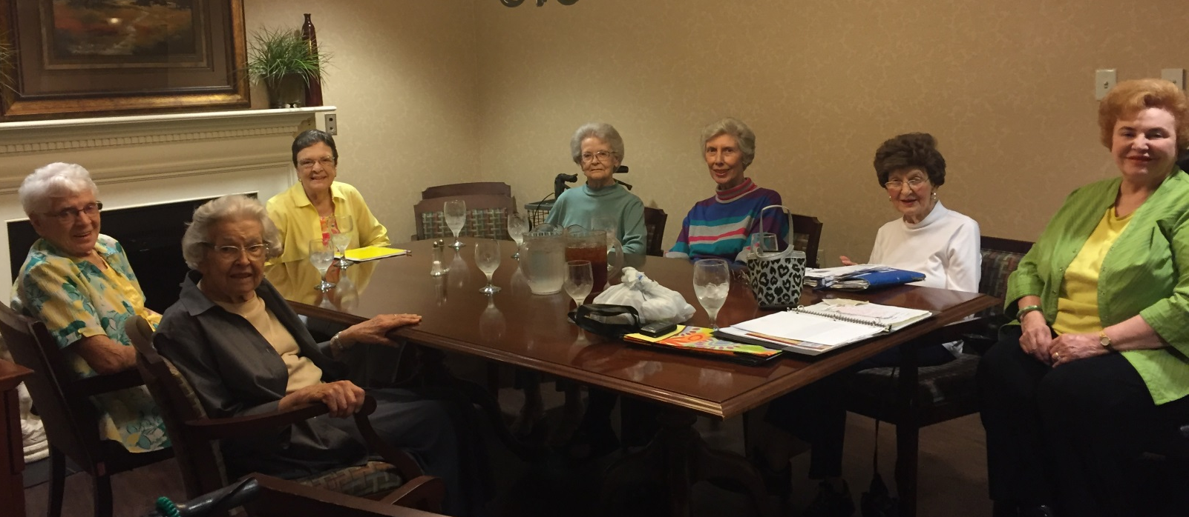
GROUP VOLUNTEER RECRUITMENT
RETIRED NURSES’ GROUP
Woodland Heights Retirement Village
Notes:
I would like to give you a quick glimpse of our groups – because each one has its own story and there have been both ups and downs:
Again this all started with this group of ladies at Woodland Heights (who have become like family to me!) and this has continued to other independent living communities…
This is my first group - retired nurses at Woodland Heights. The oldest and probably most active in this picture is 93 years old - Velma Jones (in the white shirt) – she is also a member of our advisory council and attends all our quarterly meetings. The other volunteer I want to point out in this picture is Evelyn Canady, in the bright green shirt on the right, who is the ring leader of this group, and she happens to be wheelchair bound.
What is important to know is that in each group after the first couple of initial meetings, we establish a leader to take over the monthly meetings.

Slide 16
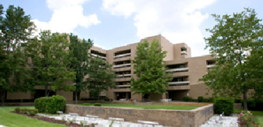
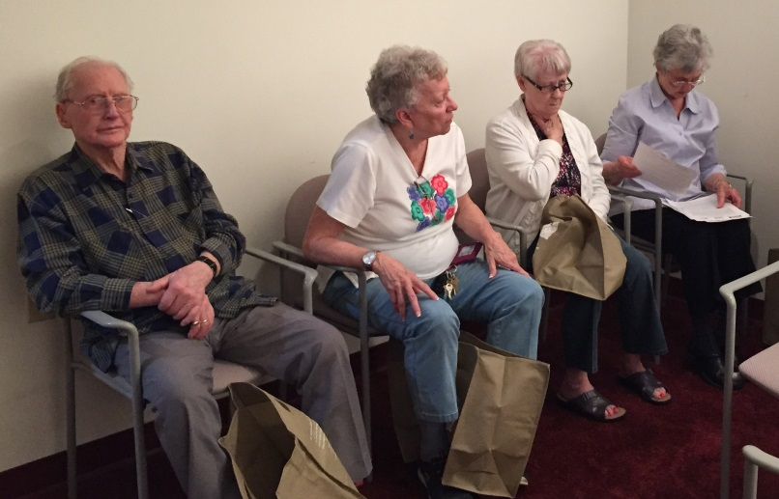
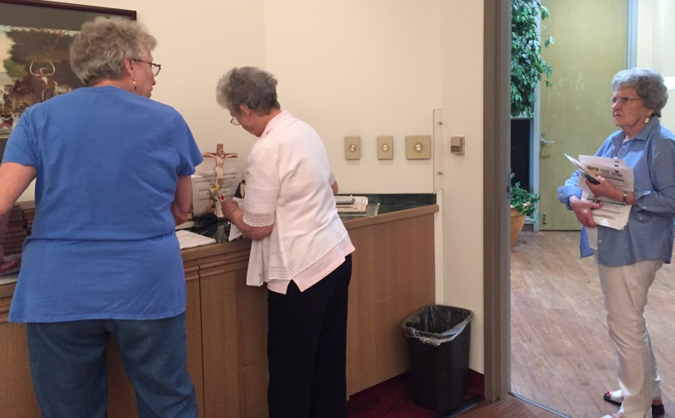
GROUP VOLUNTEER RECRUITMENT
PARKSTONE PLACE
Volunteer Group
Ken, Patty, Nellene, Doreen
Notes:
This was a particularly hard group to get going because they did not think “ANYONE IN THEIR COMMUNITY NEEDED TO KNOW THIS INFORMATION – THEY ARE SMART!
They were pretty skeptical, but with the help of their administrator, we got it off and going. The man on the left, Ken, was the one who was the most surprised from the response he was giving from his neighbors….he said he was really surprised that they were receptive of the materials and actually look forward to receiving them! – he said I am ‘pleasantly’ surprised!

Slide 17
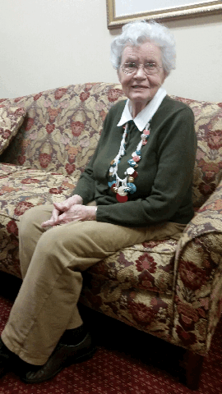
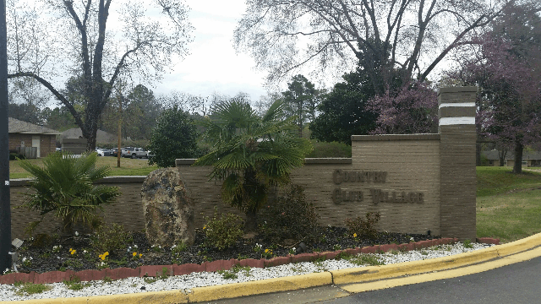
GROUP VOLUNTEER RECRUITMENT
COUNTRY CLUB VILLAGE
Volunteer Group
Dorothy Kennedy
Betty, Frances, Grace, Martha, Wayne
Notes:
This is Country Club Village
This all started with Dorothy Kennedy – a retired nurse – who saw our article in the ASBN Update magazine – a magazine sent to all nurses statewide both active and retired. This article was an attempt to recruit retired nurses.
One volunteer in this group did not want to be the leader, but she has done a marvelous job holding the group together. We started with about 12 volunteers, now we have 4 in this facility and for various reasons as you can imagine – because of the nature of the beast working with the elderly – people have surgeries, spouses die, they move out, they get sick or even die.

Slide 18
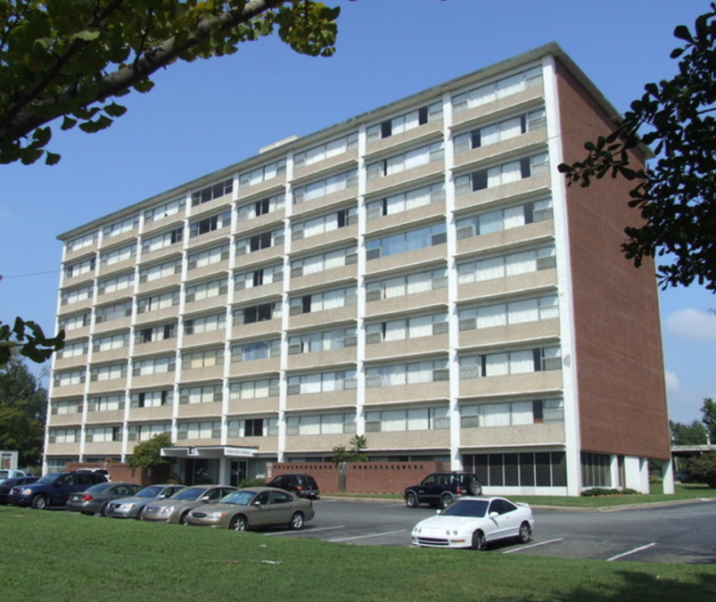
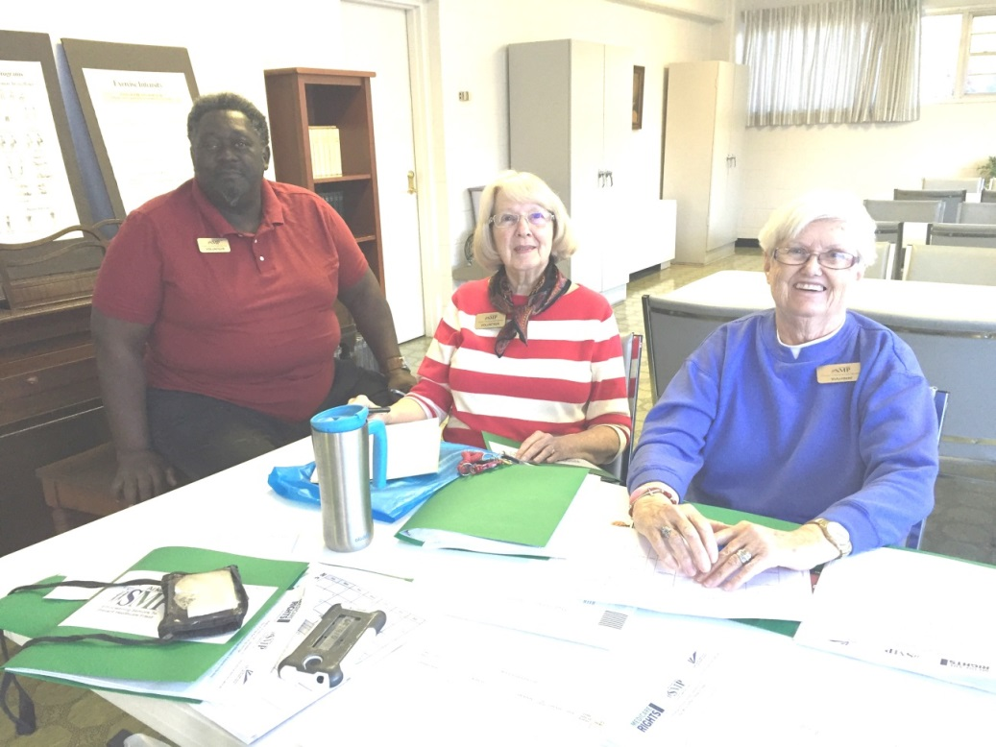
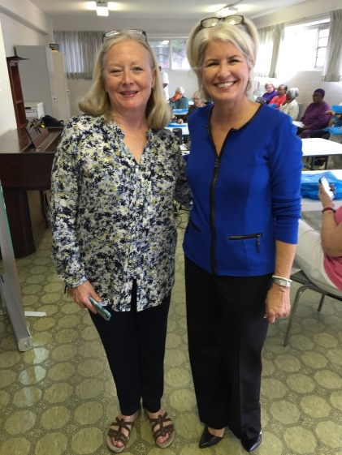
GROUP VOLUNTEER RECRUITMENT
PARKVIEW TOWERS
Volunteer Group
Hersie, Mary Alice, Barb
Administrator, Jo
Notes:
These 3 are go-getters and have split all floors among them!

Slide 19
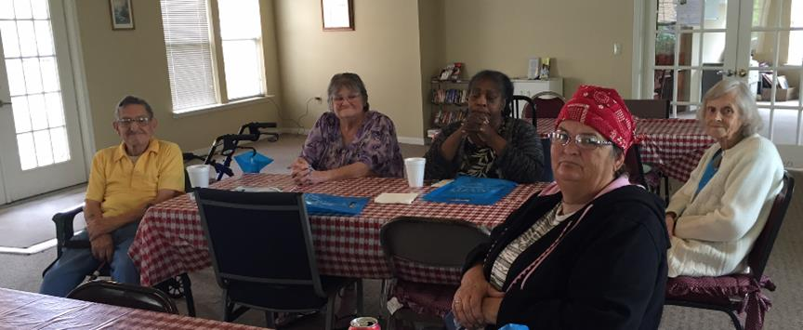
GROUP VOLUNTEER RECRUITMENT
ST. ANTHONY
Volunteer Group
Notes:
This is a fairly new group. Sadly, the man on the left recently passed away. I wonder if you could pick the ‘ring leader’ in this group?
She is a PISTOL!

Slide 20
GROUP VOLUNTEER RECRUITMENT
MOUNTAIN VIEW TOWERS
Volunteer Group
Administrator, Lillie
Notes:
I COULD NOT FIND THE PICTURE OF OUR VOLUNTEER GROUP AT THIS FACILITY, BUT THIS IS MY VOLUNTEER COORDINATOR DEE EDWARDS WITH THE FACILITY DIRECTOR LILLIE. THIS PARTNERSHIP ONLY WORKS AS LONG AS YOU HAVE A RELATIONSHIP WITH AND SUPPORT OF THE ADMINISTRATOR OR DIRECTOR.

Slide 21
GROUP VOLUNTEER RECRUITMENT
OTHER COMMUNITIES
IN THE WORKS:
Wesley on the Ridge (1 Vol – 35 apts)
West Shores
Brookstone
Butterfield Trail
Christopher Homes
Notes:
Christopher Homes is a good starting point.
Wesley on the Ridge is a small community and we have one volunteer there who wants to do it on her own.
We are attempting to recruit at least one housing facility in each county of our state (75!)

Slide 22
Step 4….
Notes:
In all presentations we have a call to volunteers. This video was also produced using our own volunteers. We had so many volunteer who wanted to take part in this production that we were able to make 3 identical commercials so all the volunteers could appear at least once!
It has been with Dee’s help to really work as a team with recruiting while I am speaking to others one-on-one about suspected fraud and other issues after each presentation.

Slide 23
Questions?
Thank you!

